Slide 1
Debugging
All really good programmers are good debuggers.

Slide 2



Order-of-Evaluation Errors
The increment and decrement operators are used in most C programs, and the order in which the operations take place is affected by whether these operators precede or follow the variable

Slide 3
Pointer Problems
A very common error in C programs is the misuse of pointers.
Pointer problems fall into two general categories:
misunderstanding indirection and the pointer operators,
and accidentally using invalid or uninitialized pointers.

Slide 4
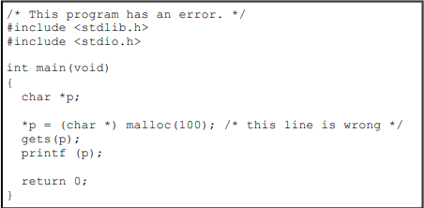
Pointer Problems

Slide 5
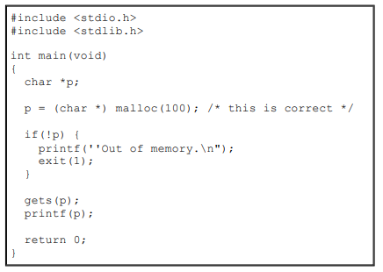
Pointer Problems
There is no runtime check on the address returned by malloc( ). Remember, if memory is exhausted, malloc( ) returns NULL

Slide 6

Pointer Problems
x has not been initialized to point to anything

Slide 7
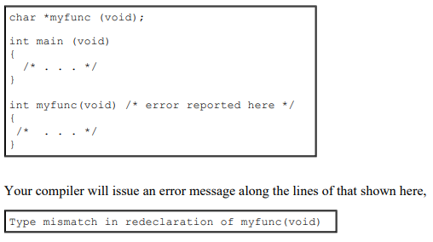
Interpreting Syntax Errors
Once in a while you will see a syntax error that does not make sense

Slide 8

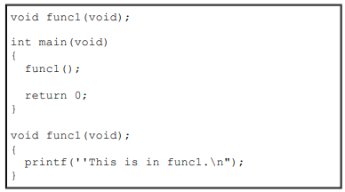
Interpreting Syntax Errors
Compiler error:
bad declaration syntax

Slide 9
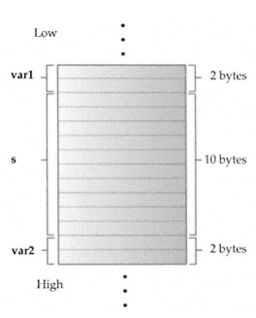
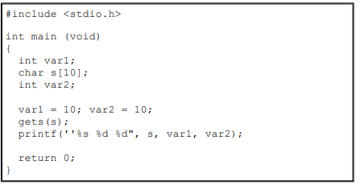
Boundary Errors
The fgets( ) function lets you specify the maximum number of characters to read. The only trouble is that fgets( ) also reads and stores the newline character, so you will need to strip that off in most applications.

Slide 10
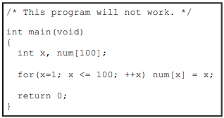
One-Off Errors
in C all array indexes start at 0

Slide 11
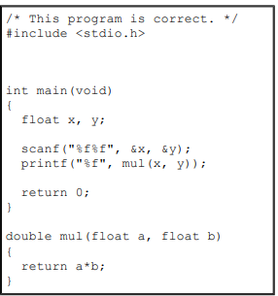
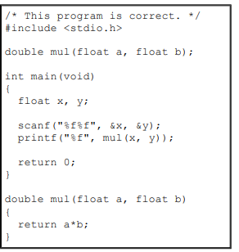
Function Prototype Omissions

Slide 12

Argument Errors
You must be sure to match whatever type of argument a function expects with the type you give it. While function prototypes catch many argument/parameter type mismatches, they can't catch all.

Slide 13
Stack Overruns
All C compilers use the stack to store local variables, return addresses, and parameters passed to functions. However, the stack is not infinite and it can be exhausted. This results in a stack overrun.
runaway recursive functions

Slide 14
Using a Debugger
Many compilers provide a debugger, which is a program that helps you debug your code.
In general, debuggers work by allowing you to execute your code step by step, set breakpoints, and inspect the contents of variables.
Modern debuggers, such as that provided by Visual C++, are truly wonderful tools that can help find problems in your code.
A good debugger is worth the time and effort it takes to learn to use it effectively.
However, a good programmer never substitutes a debugger for solid design and craftsmanship.

